Slide 1
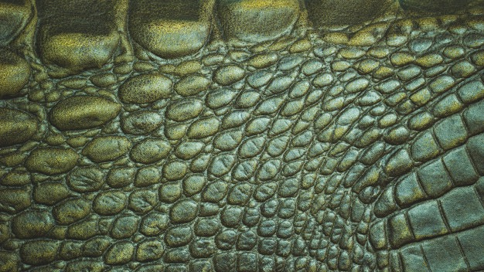
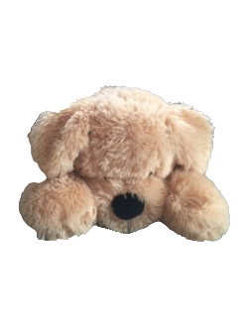
Waffle’s Dinosaur Adventure
Monday: Dinosaur Facts
Choose a dinosaur to research.
Create a fact sheet about your chosen dinosaur.
Remember a fact sheet has:
A title.
A labelled picture of your dinosaur.
5 facts about your dinosaur.
A “did you know” section.

Slide 2
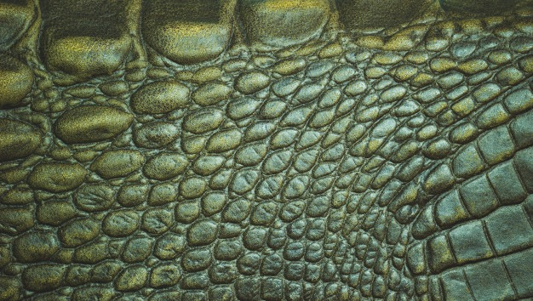
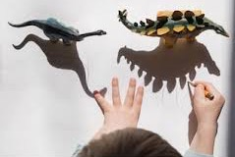
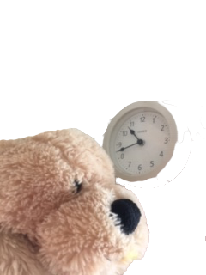
Waffle’s Dinosaur Adventure
Tuesday: Shadow Drawing
Make some shadow drawings.
If you don’t have toy dinosaurs any toy will work!
Make one drawing in the morning, one at 12 o’clock and another in the afternoon.
What do you notice?

Slide 3

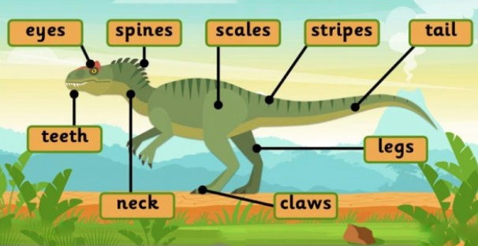
Design and label a dinosaur.
Waffle’s Dinosaur Adventure
Wednesday: Dinosaur Designs
What colour is it?
Does it have a pattern?
Does it have horns or spikes?

Slide 4
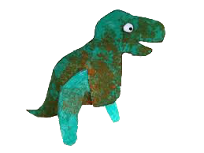
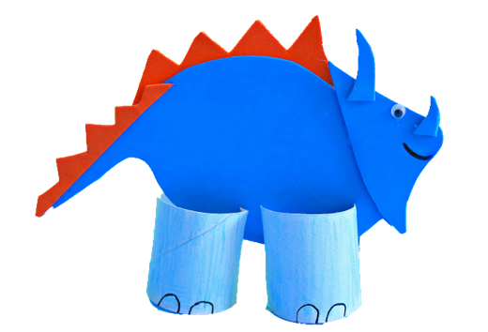
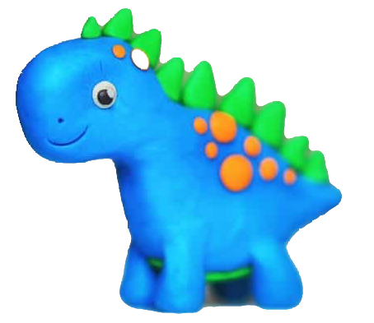
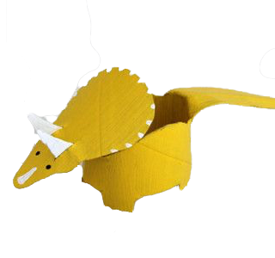
Make a model dinosaur.
Waffle’s Dinosaur Adventure
Thursday: Dino Models

Slide 5

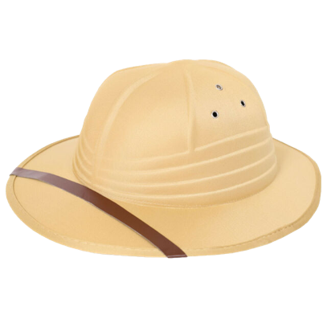
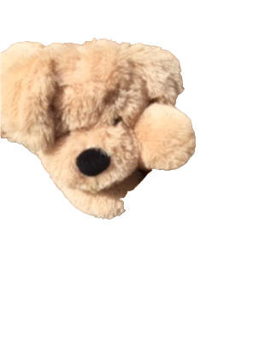
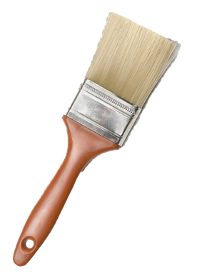
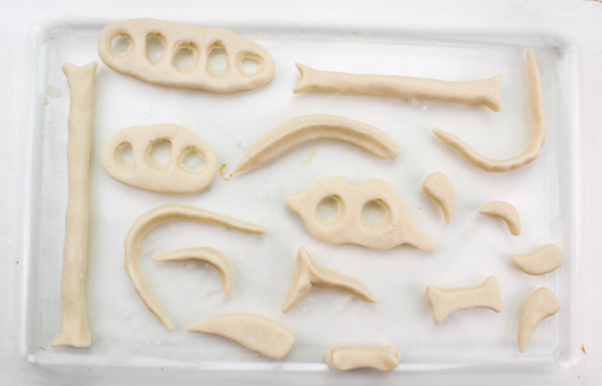
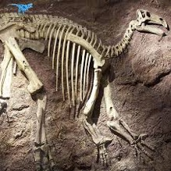
Waffle’s Dinosaur Adventure
Friday: Dinosaur Bone Bake
Make some Salt Dough dinosaur bones
You will need
250g of flour
125g of salt
125 ml of water
If you have a sand and a brush, you could pretend to be an archeologist.
Instructions
Put flour, salt and 1 water together in a bowl
Mix together and kneed for 2 minutes
Create your own dinosaur bone shapes.
Bake in the oven on lowest setting for 3 hours or until hard.

